Slide 1
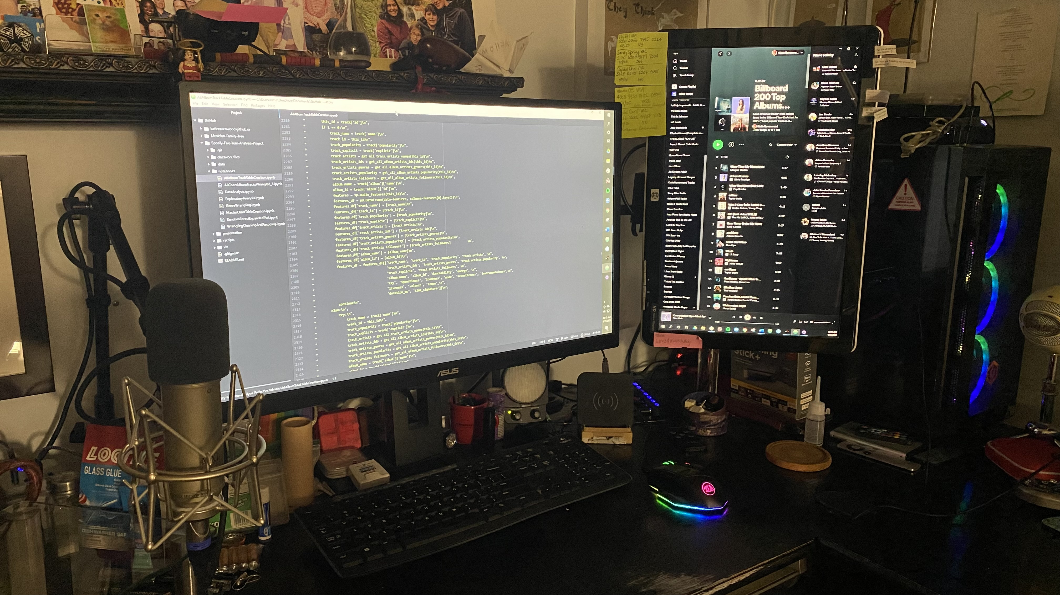
2017
2018
2019
2020
2021
https://bit.ly/SxB5YA
Good Vibrations?
Spotify x Billboard Top 200 Albums 5-Year Analysis Project
Bianca Serrano and Katie Ravenwood
Notes:
Bianca:

Slide 2
OUR QUEST
CHANGES OVER TIME
Have there been any significant changes in music over the past five years?
Are there other significant features that change over time?
Do any of the features have similarities or contrasts?
GENRE PRESENCE
MOOD
Have there been any changes in genre presence on the charts? Which genres are changing and how?
Has mood of the most popular music changed over the past five years? How has it changed?

Slide 3

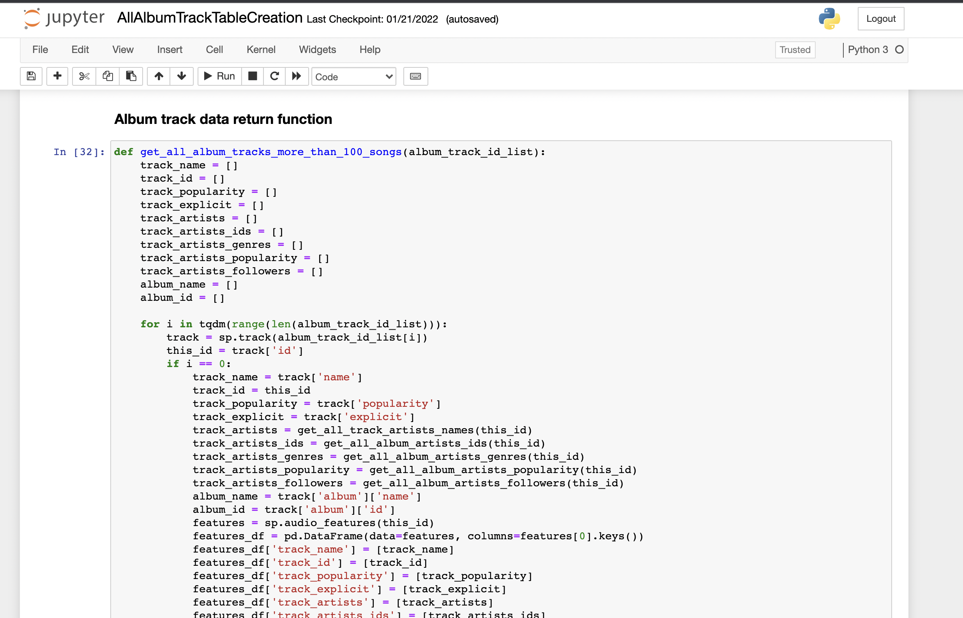
DATASET CREATION
PYTHON & SPOTIPY
8996 TRACKS FROM 560 ALBUMS
Data tables of album and track information were created with Python using the SpotiPy package.
Included variables:
Billboard album chart name & year
Album ID, name, release year
Album artists' names, IDs, popularity, and associated genres
Track IDs, popularity, and statistics
Explicit labeling designation
Audio features
Notes:
To create the dataset, we used the SpotiPy package for Python, which offers efficient communication with the Spotify API and access to the JSON endpoints in Spotify’s Data Catalogue.
Each playlist featured information for 200 albums, some of which were repeated over the yearly charts. In order to pull all of the data we had to create a script to work with and around Spotify’s rate limits which capped returned data to 100 tracks at a time, so we designed a function that allowed timing and pull requests to be paced to communicate steadily with the API while returning all of the necessary information. The code for this can be seen in our GitHub repo for the project.
The script allowed us to pull data from 8996 tracks from 560 albums into a single data table.

Slide 4
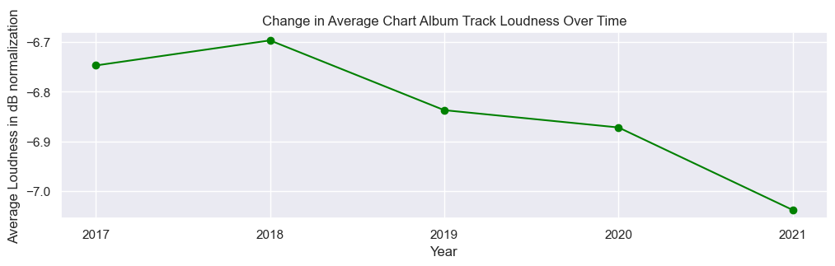
CHANGE IN LOUDNESS OVER TIME
-6.75 dB
-6.70 dB
-6.84 dB
-6.87 dB
-7.04 dB
2017
2018
2019
2020
2021
Notes:
B:

Slide 5
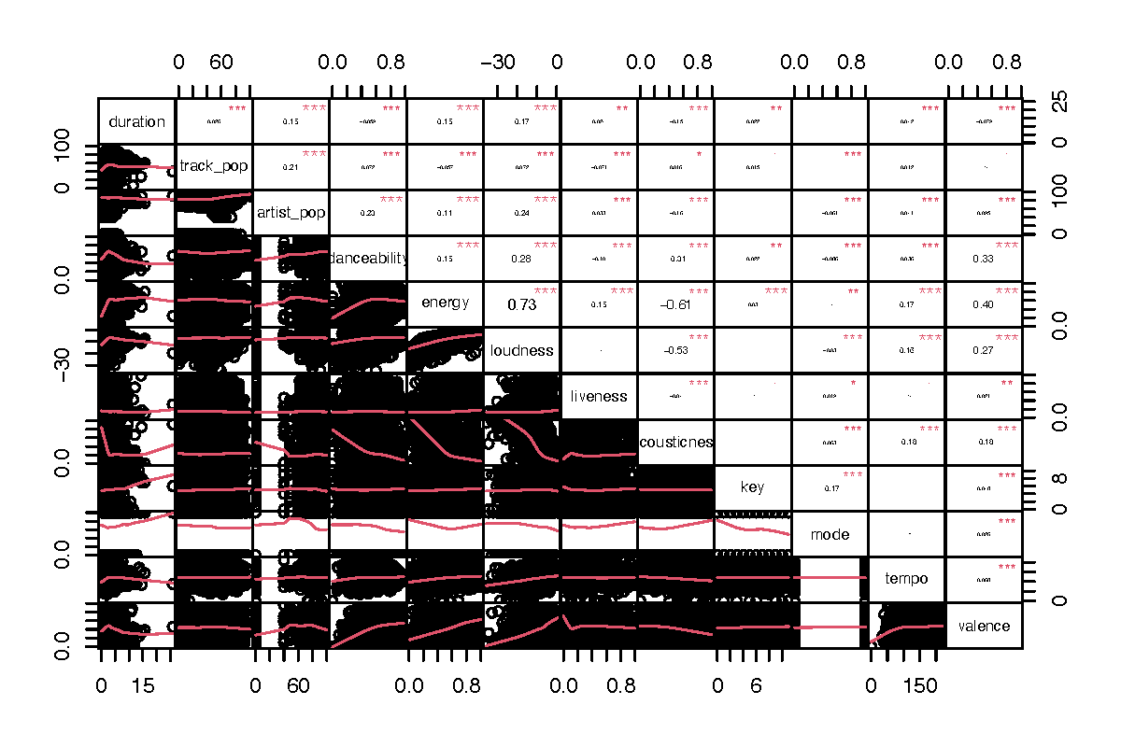
CORRELATION MATRIX OF FEATURES
Notes:
B:

Slide 6
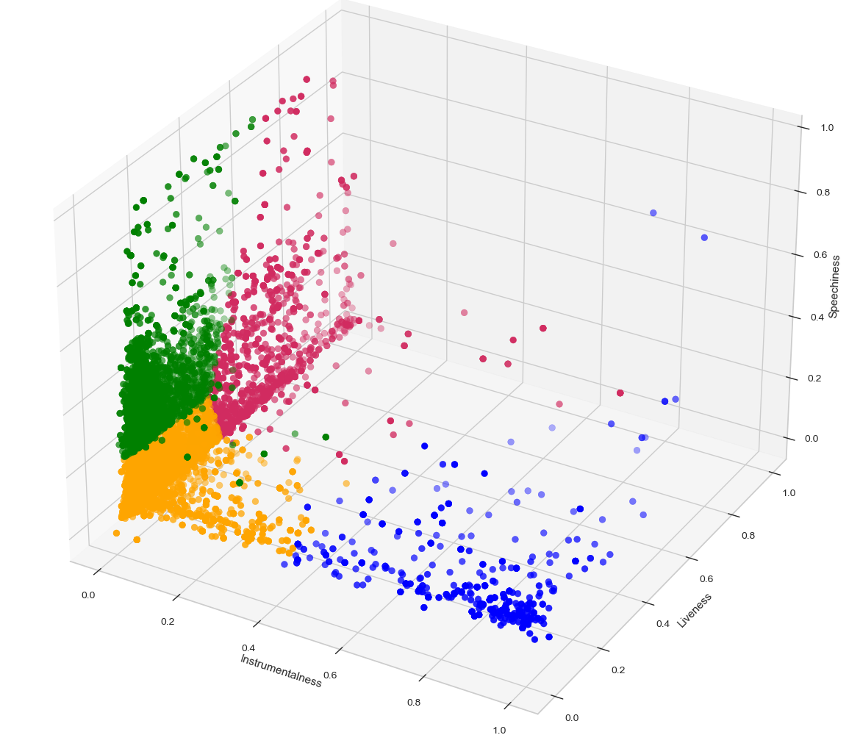
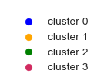
KMEANS CLUSTERS
1st Cluster:
Mid-high instrumentalness
Low-mid liveness
Low-mid speechiness
2nd Cluster:
Low-mid instrumentalness
Low-mid liveness
Low-mid speechiness
3rd Cluster:
Low instrumentalness
Low-mid liveness
Mid-high speechiness
4th Cluster:
Low instrumentalness
Mid-high liveness
Low-mid speechiness

Slide 7
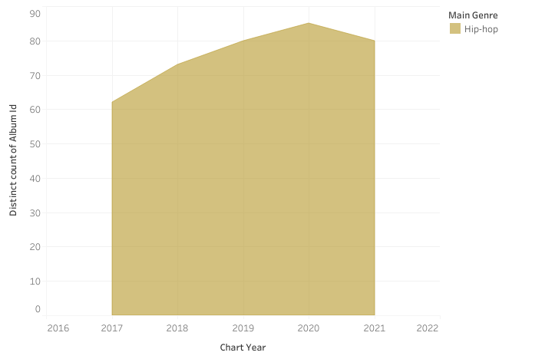
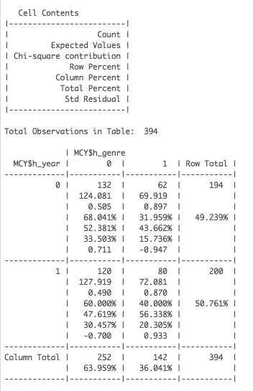
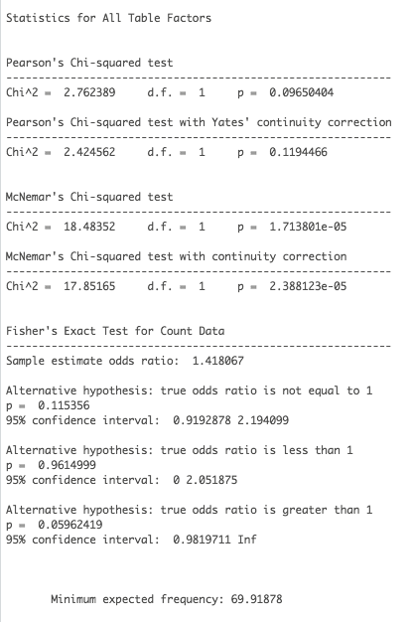
ALBUM COUNT PER CHART YEAR FOR HIP-HOP GENRE

Slide 8
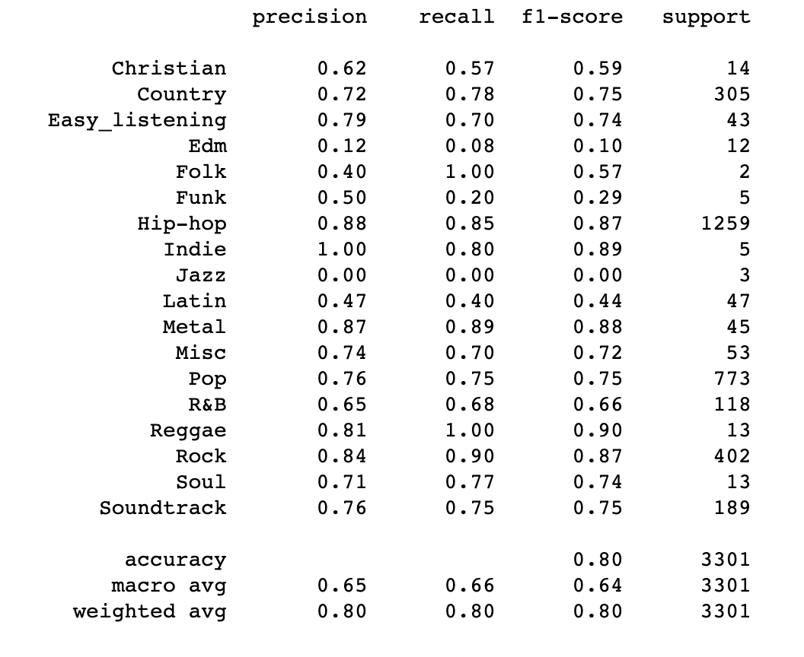
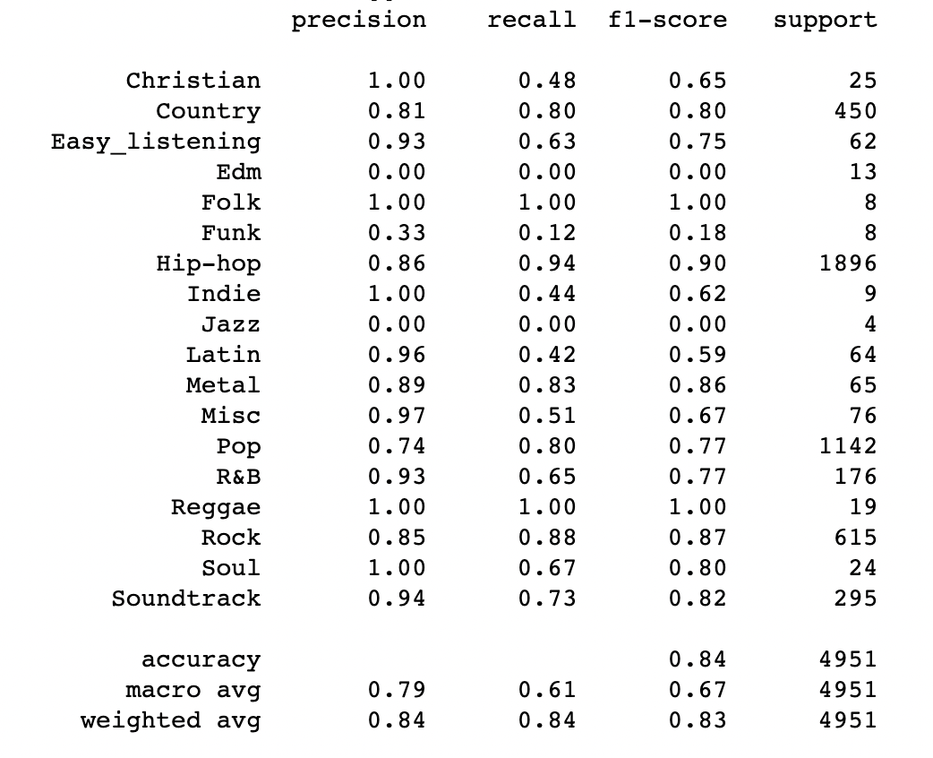


GENRE CLASSIFICATION
K Nearest Neighbors
Random Forest Classifier

Slide 9
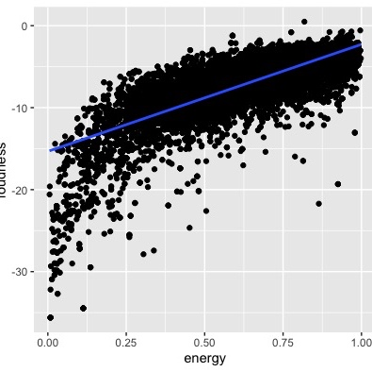
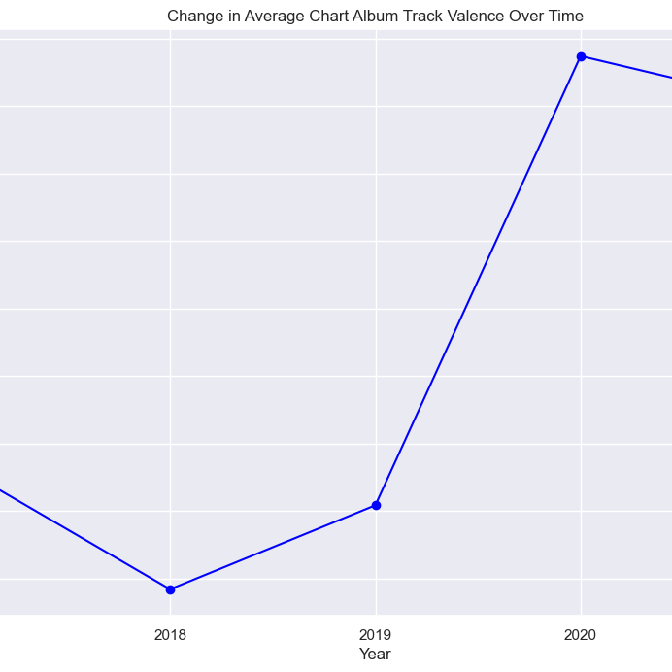
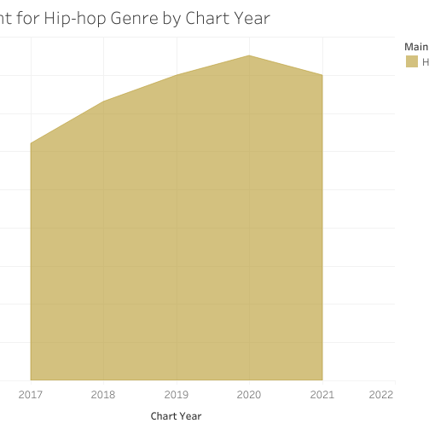
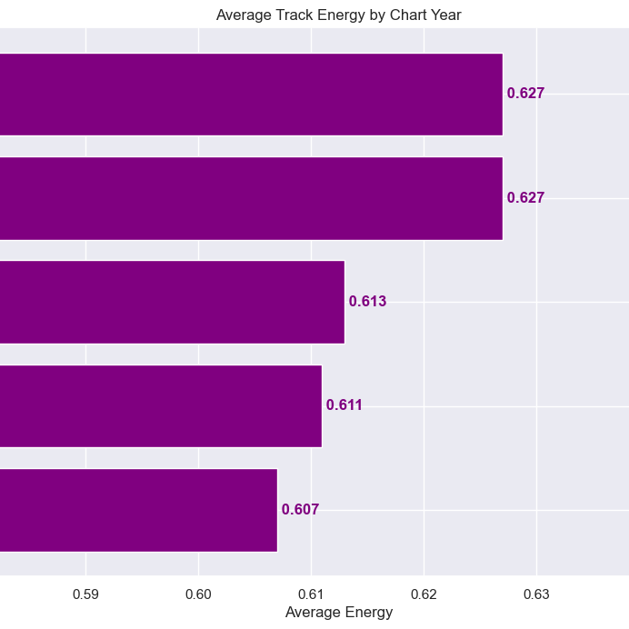
SUMMARY
GENRE PRESENCE
ENERGY CHANGE
Hip-hop presence on the charts increased while albums in the the Country genre decreased.
Average track energy decreased during the five-year analysis period.
CORRELATIONS
VALENCE CHANGE
Energy was significantly correlated with loudness and valence.
Valence generally increased during the five year analysis period, particularly in 2020.
Notes:
Read the slide

